Slide 1
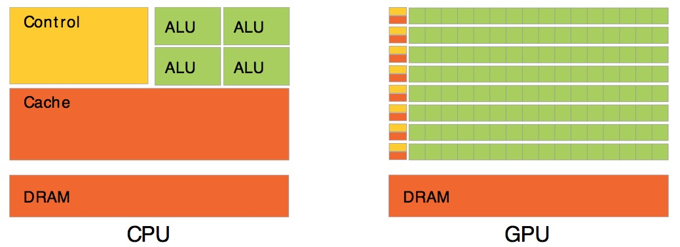
PCIe
IO Block
IO Block
Control
Cache
CPU
GPU

Slide 2
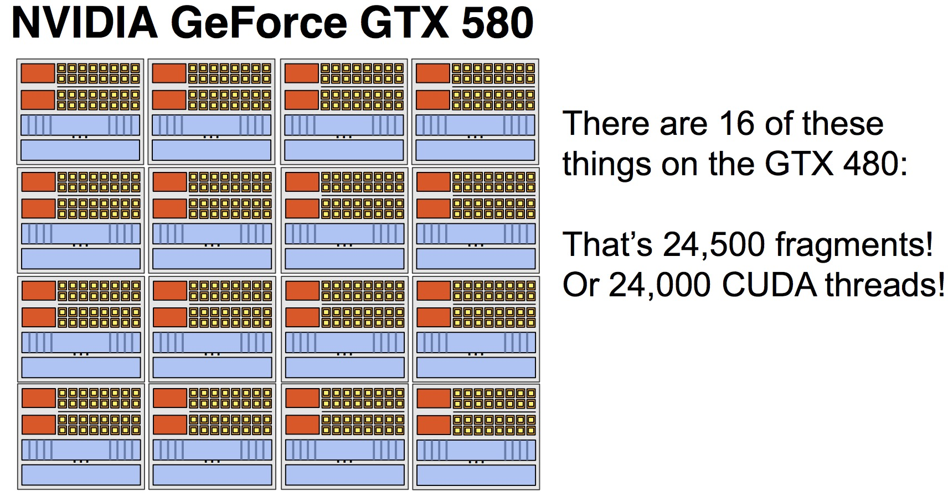
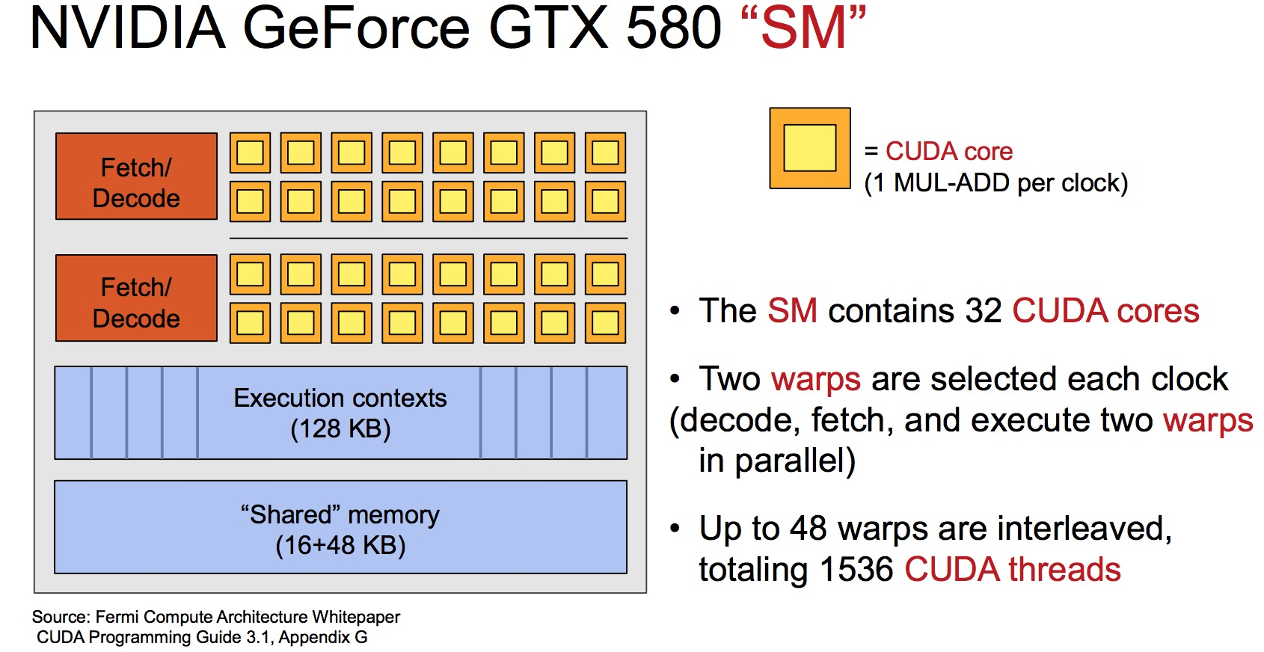

GPU
Stream Multiprocessor (SM)
Warp
Stream Processor
(CUDA Core)

Slide 3
SM-0
L2 Cache (1MB)
Memory (显存)
Global Memory
Texure Cache
(Read-only)
+
L1 Cache (64KB)
SM-1
SM-2
……………………
SM-n

Slide 4
PCIe
IO Block
IO Block

Slide 5
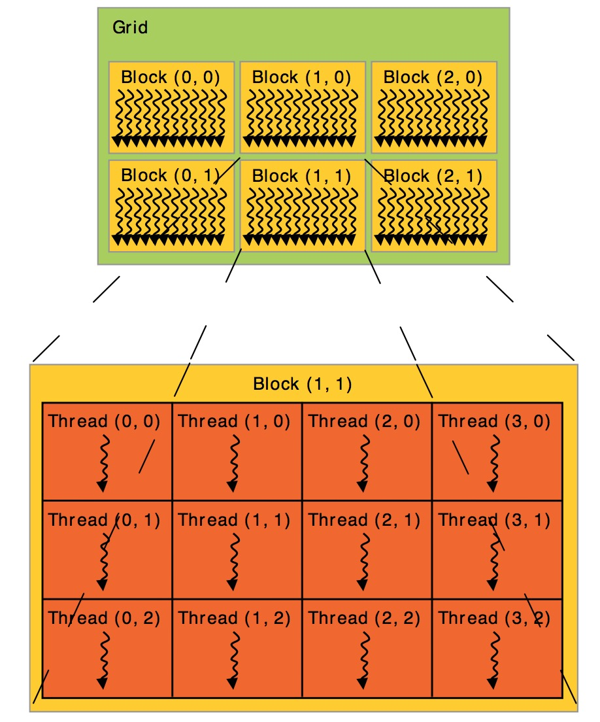

Slide 6


GPU/Muti SM
Stream Multiprocessor (SM)
Stream Processor
(CUDA Core)
Warp
Grid
Block(2,0)
Block(0,0)
Block(1,0)
Block(2,0)
Thread(0,0)
Thread(1,0)
Thread(2,0)
Thread(3,0)
Thread
Thread(0,1)
Thread(1,1)
Thread(2,1)
Thread(3,1)
Block(0,1)
Block(1,1)
Block(2,1)
Thread(0,2)
Thread(1,2)
Thread(2,2)
Thread(3,2)

Slide 7



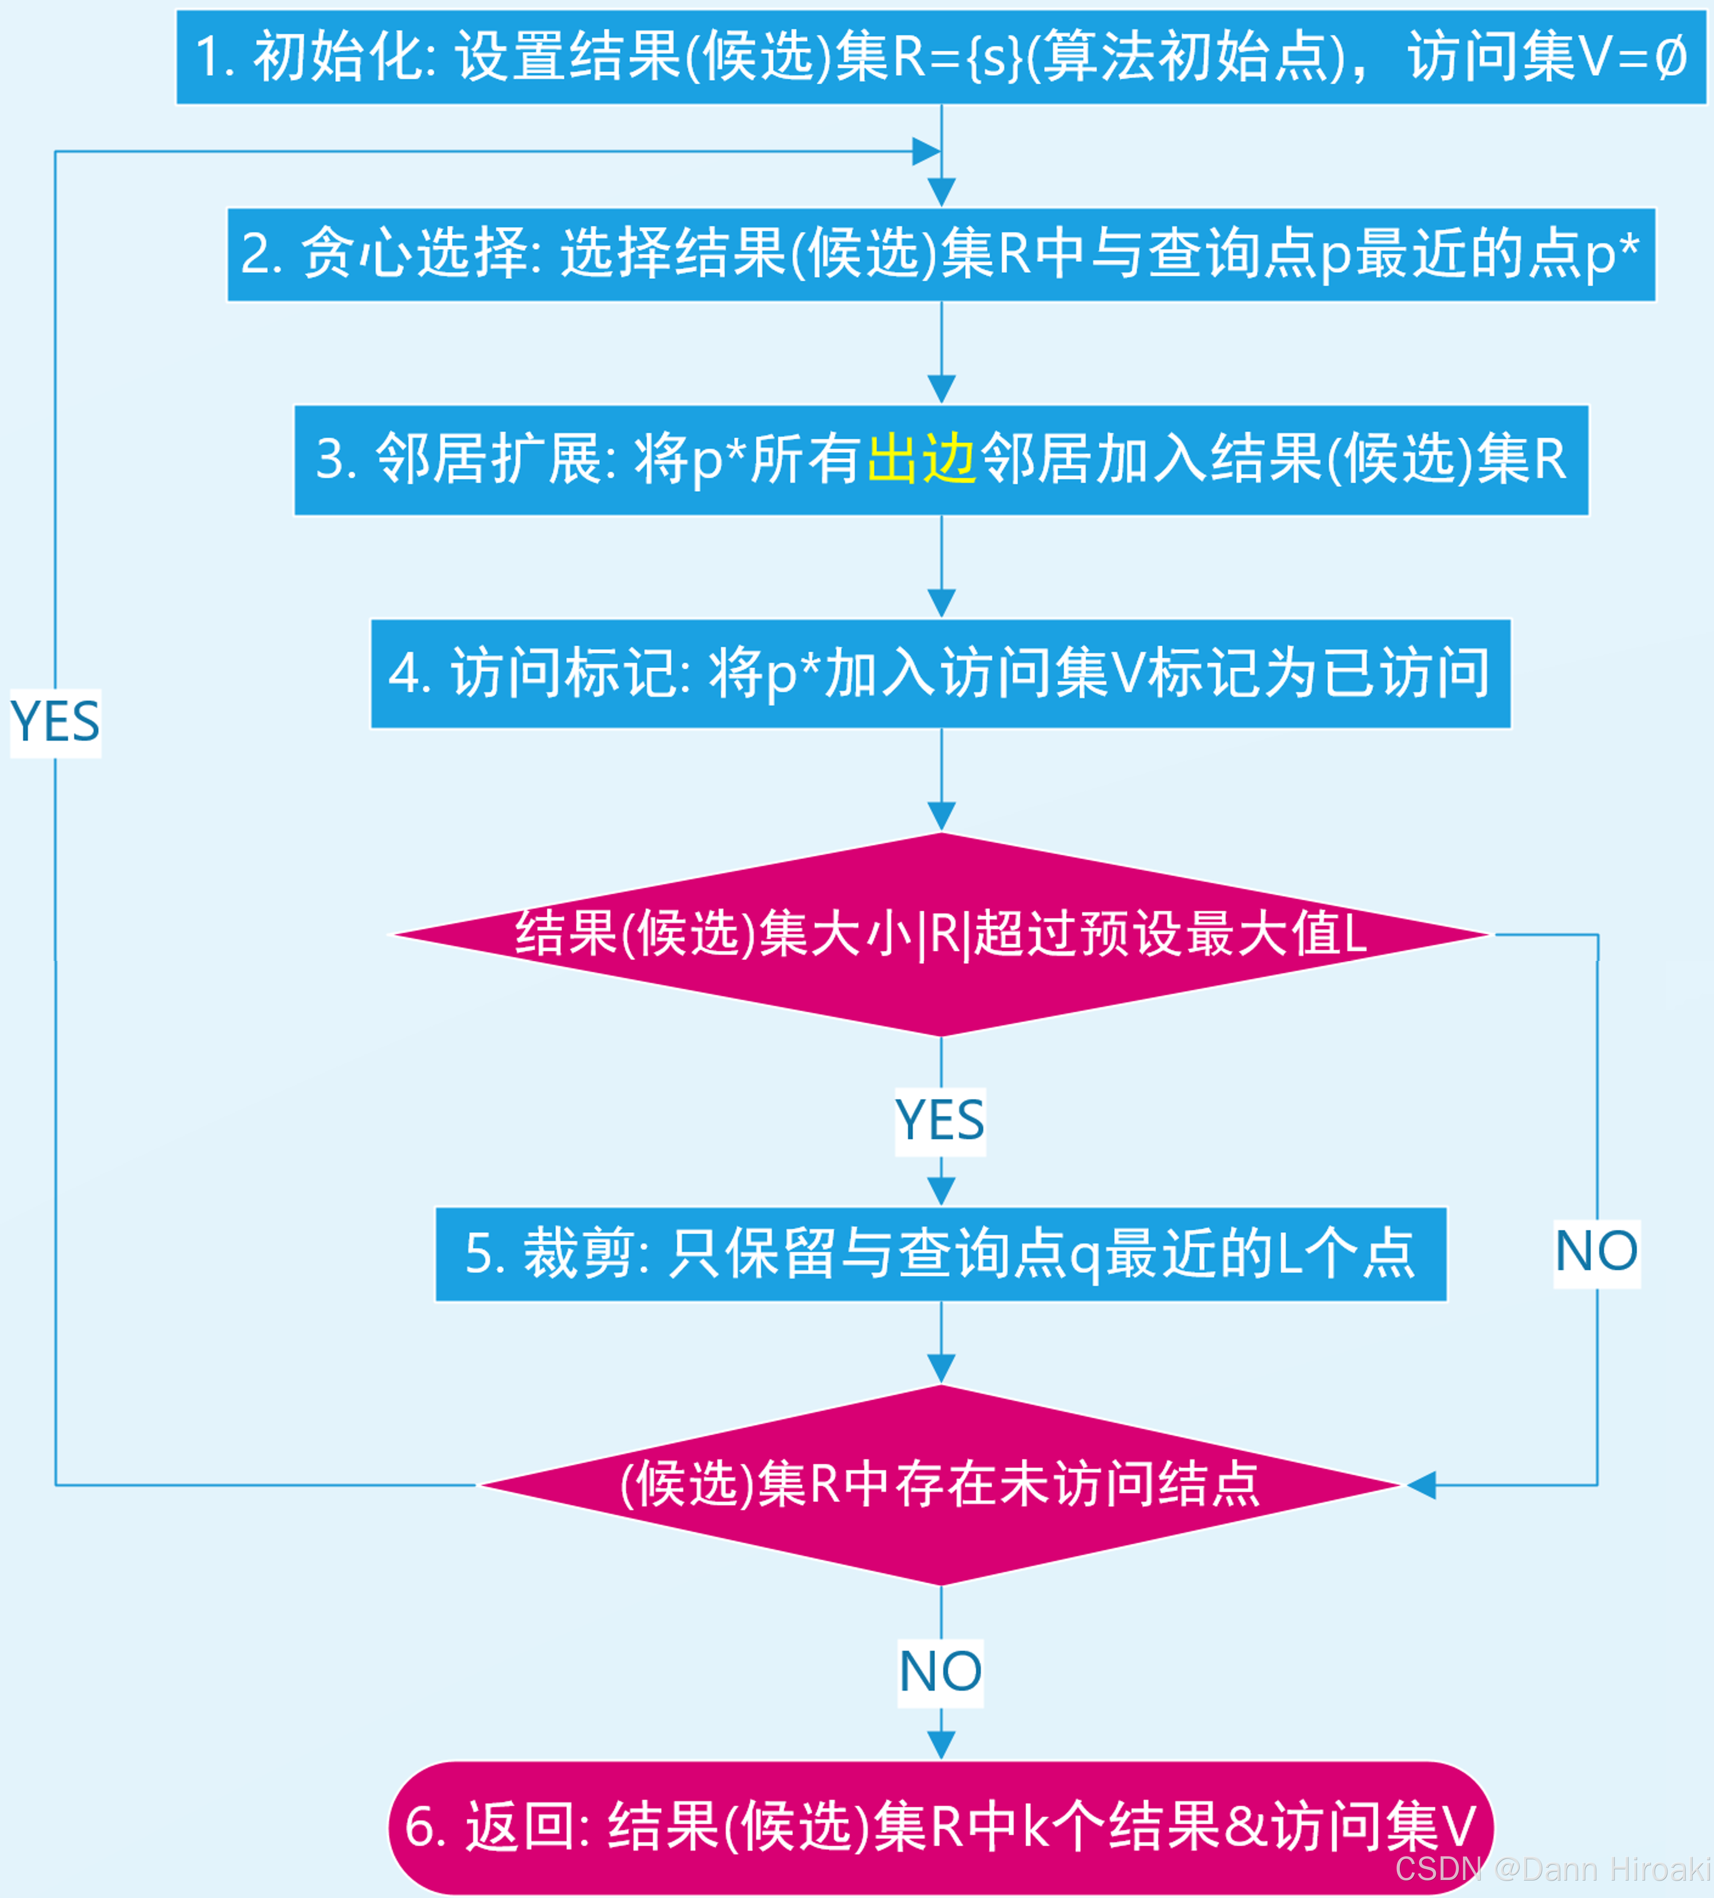
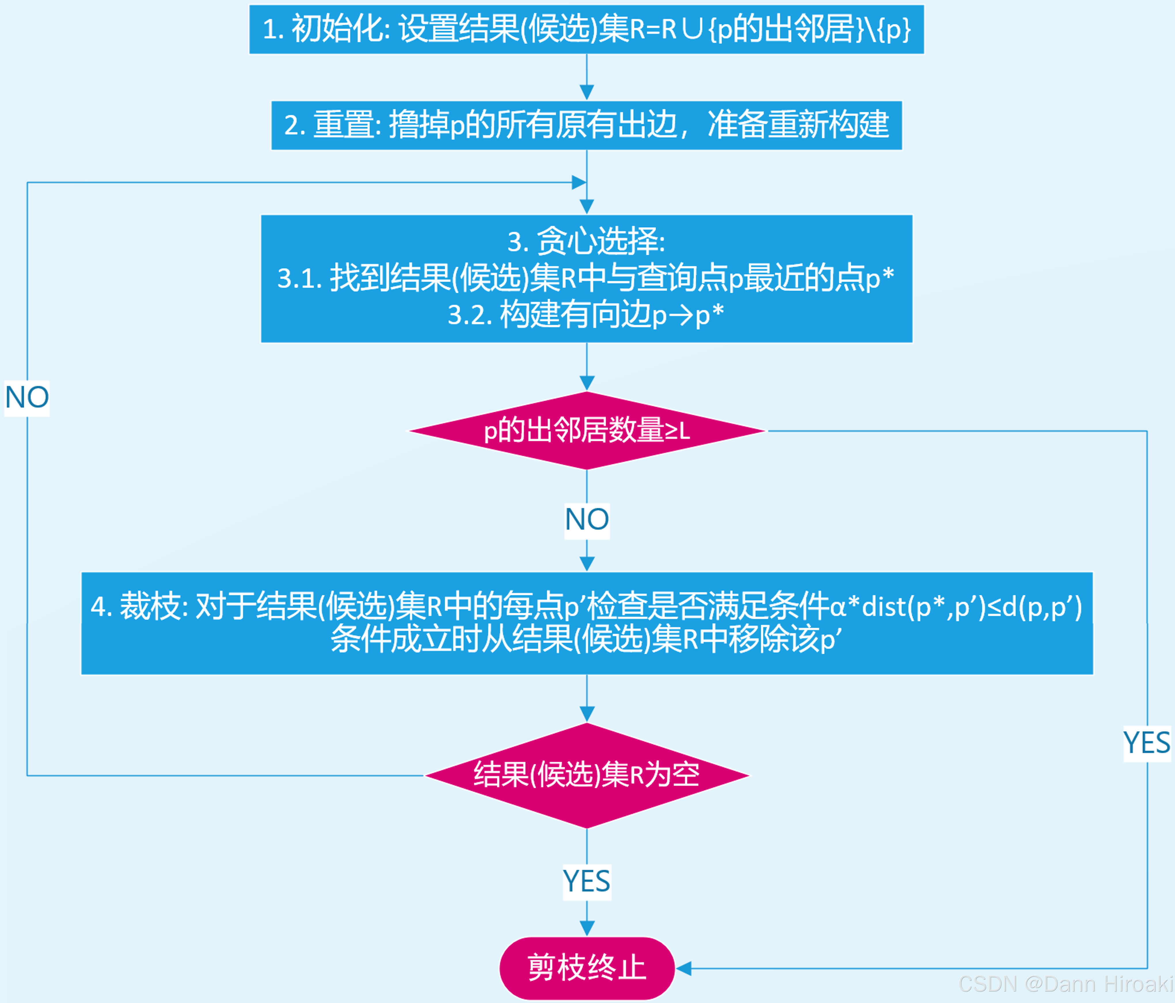

Slide 8
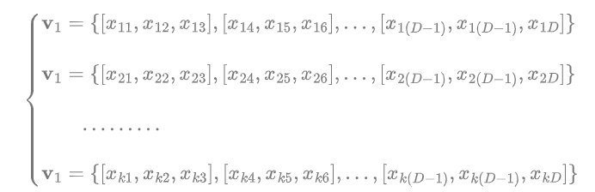
Sub-sapce1

Slide 9
GPU
并行距离计算(用压缩向量)
主存
存储图结构

Slide 10
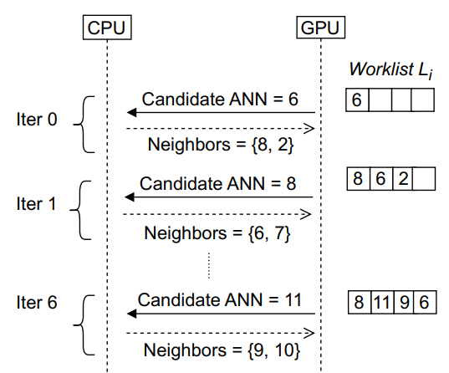
初始化
前CPU阶段
获取邻居并传给GPU
中GPU阶段:
更新WorkList
传输新candidate给CPU

Slide 11
CPU
GPU
WorkList
候选ANN=n1
Iteration 0
n1
初始化:
(1)把质心点放入WorkList
(2)将初始点传给CPU
n1邻居n2/n3
n1 | n2 | n3
前CPU阶段:
(1)CPU找出当前(候选)点邻居
(2)将邻居传给GPU
中GPU阶段:
(1)滤掉已访问邻居
(2)计算距离并排序
(3)合并排序结果到原有WorkList
Iteration 1
候选ANN=n3
n3 | n2
后CPU阶段:
(1)将Worklist最近点(下一候选点)给CPU
(2)判断是否结束收敛/结束
n3邻居n4
n3 | n2 | n4
前CPU阶段
Iteration 2
中GPU阶段
候选ANN=n4
n4 | n2
后CPU阶段
………………

